Slide 1
Lean Startup Explained

Slide 2
What is entrepreneurship?
Notes:
Vision Workshop: Spread pictures on the table; each person picks 3-5 and explains their choice; these are then grouped in themes with one picture selected by the group to represent each theme. The picture and theme is the stuck on the flipchart and someone selected to summarise to the group (repeat for future state with same pictures)

Slide 3
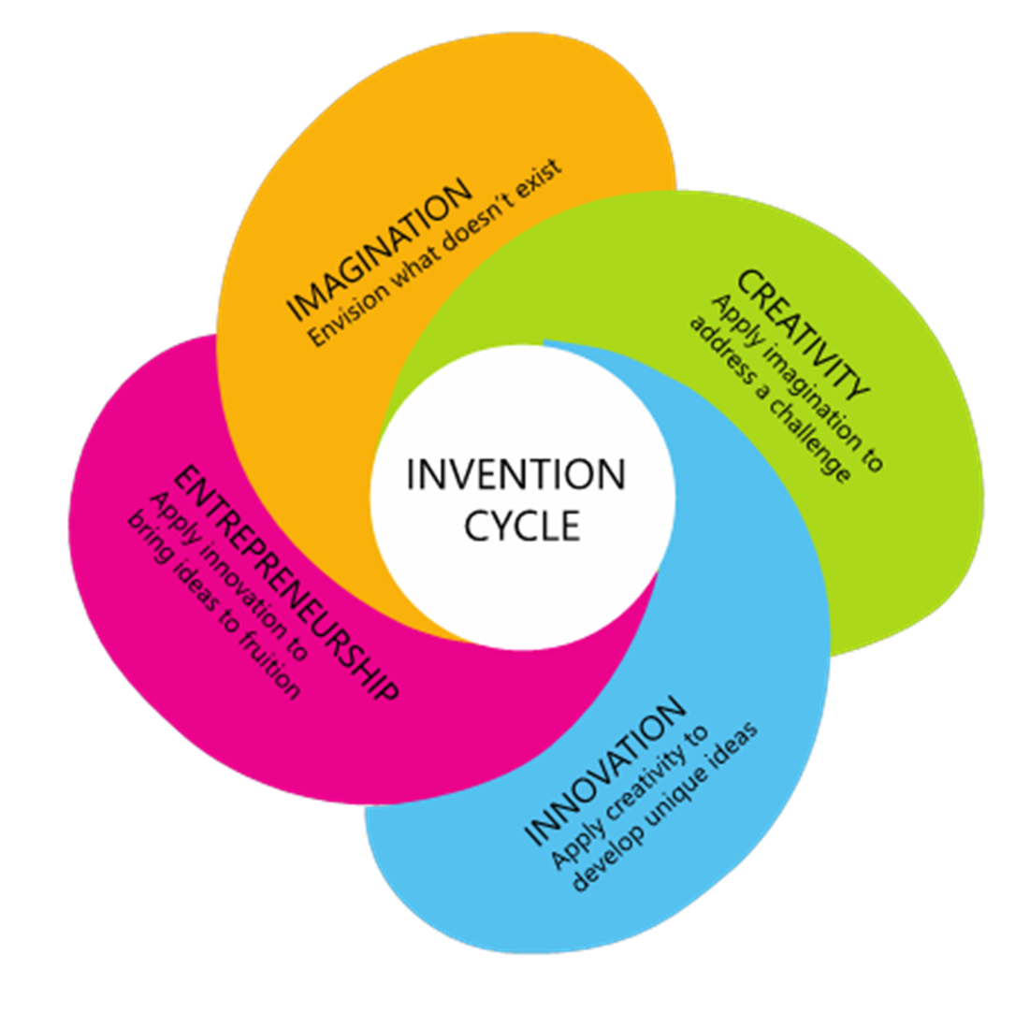
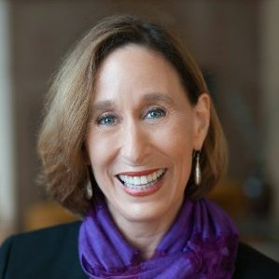
The Invention Cycle
Imagination | …is the ability to envisage that which doesn’t exist. | New to me.
Creativity | …is the application of imagination to address a challenge.
Innovation | …is the application of creativity to develop unique ideas. | New to the world.
Entrepreneurship | …is the application of innovation to bring ideas to fruition and spark the imagination of others.
Dr. Tina Seelig is a Professor of the Practice in the Dept of Management Science and Engineering (MS&E) at Stanford School of Engineering.
She is a faculty director for the Stanford Technology Ventures Program (STVP), the entrepreneurship center at Stanford's School of Engineering

Slide 4
Why do it?
(I mean, really… why?)
Notes:
Vision Workshop: Spread pictures on the table; each person picks 3-5 and explains their choice; these are then grouped in themes with one picture selected by the group to represent each theme. The picture and theme is the stuck on the flipchart and someone selected to summarise to the group (repeat for future state with same pictures)

Slide 5
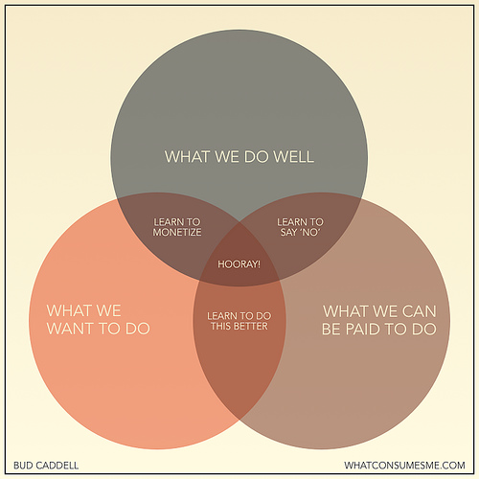
Autonomy, Mastery & Purpose

Slide 6
Being and entrepreneur is about having a vision and being able to communicate that vision.
Notes:
Vision Workshop: Spread pictures on the table; each person picks 3-5 and explains their choice; these are then grouped in themes with one picture selected by the group to represent each theme. The picture and theme is the stuck on the flipchart and someone selected to summarise to the group (repeat for future state with same pictures)

Slide 7
What is the difference between a Startup and a Company?
Notes:
Vision Workshop: Spread pictures on the table; each person picks 3-5 and explains their choice; these are then grouped in themes with one picture selected by the group to represent each theme. The picture and theme is the stuck on the flipchart and someone selected to summarise to the group (repeat for future state with same pictures)

Slide 8
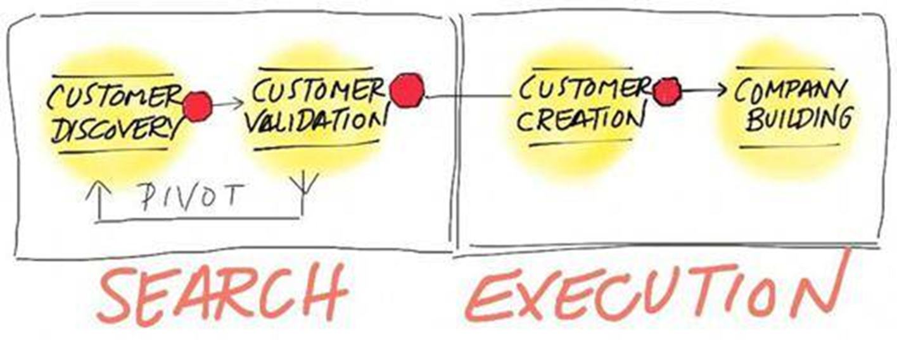
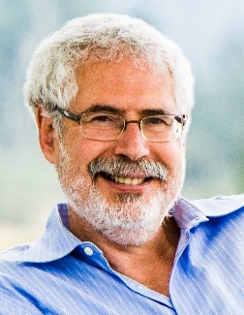
The Four Steps
Steve Blank has been referred to as a ‘Godfather of Entrepreneurship’ in Silicon Valley. He has spent over 30 years within the high technology industry, founding or working within eight startup companies, four of which have gone public. He is an adjunct professor of entrepreneurship at Stanford; lecturer at the UC Berkeley Haas School of Business, and is a senior fellow at Columbia University, and New York University. He is a co-founder of the Lean Startup movement.

Slide 9
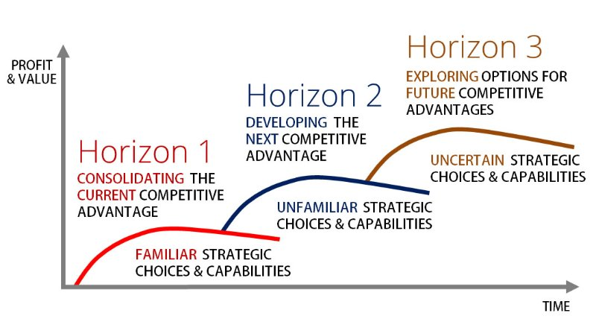

Slide 10
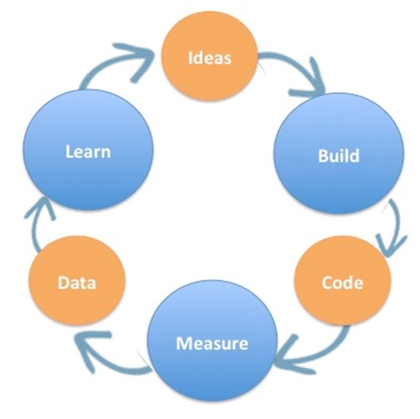
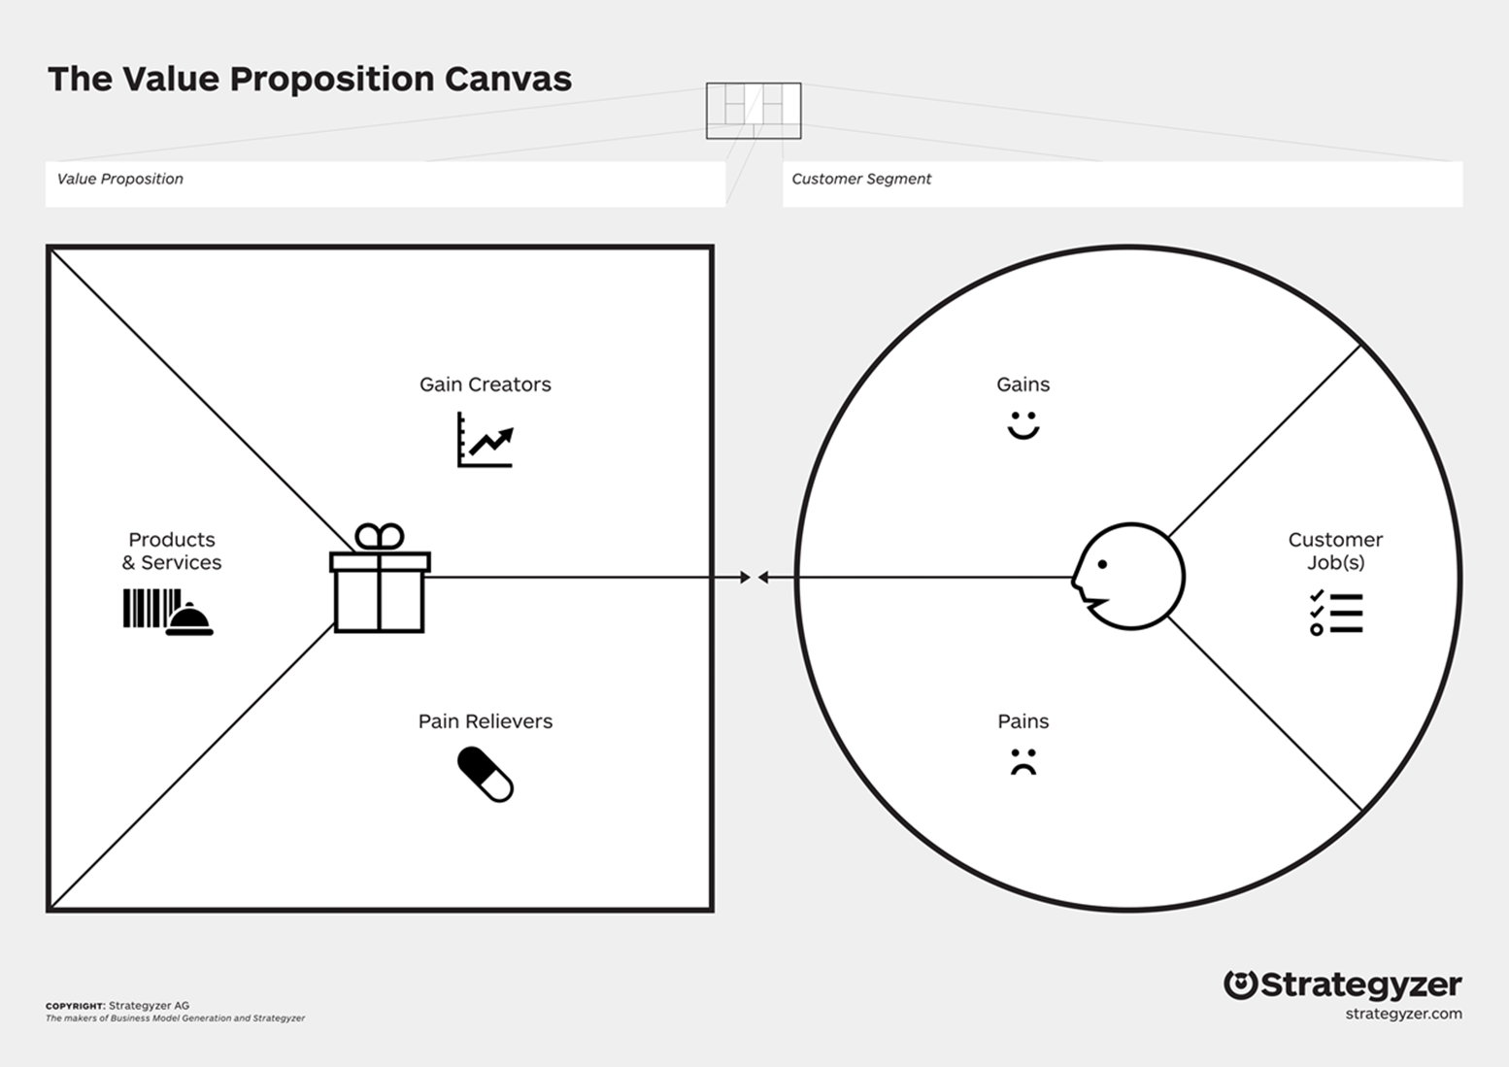
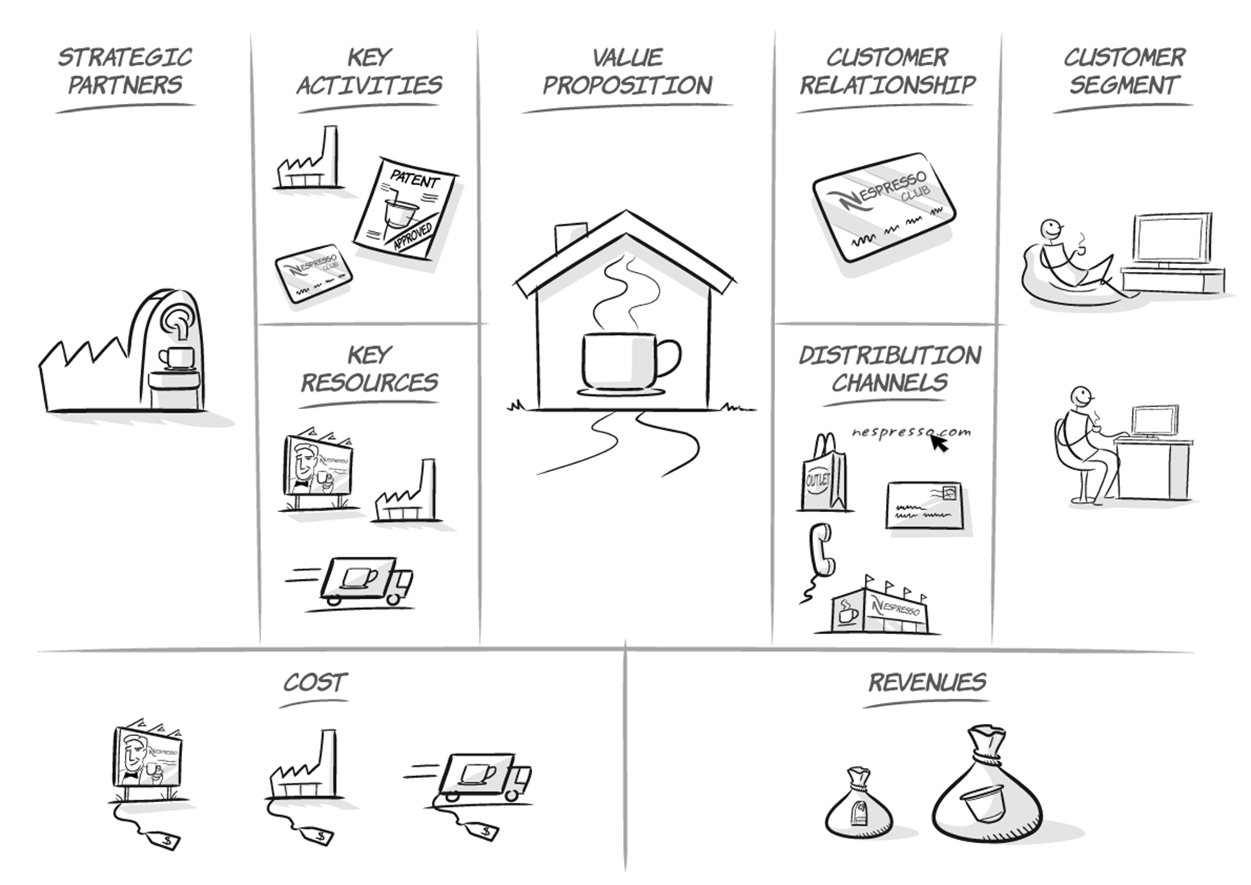
What is Lean Startup?
Customer Development + | Business Modelling + | Agile Development
Customer Interviews (UX) | Business Model Canvas (Design Thinking) | Build – Measure – Learn Feedback Loop

Slide 11
Validation is the most important concept in entrepreneurship.
Lean Startup is the science of entrepreneurship, validating your ideas while minimising waste of time, effort and resources
(…your life.)
Notes:
Vision Workshop: Spread pictures on the table; each person picks 3-5 and explains their choice; these are then grouped in themes with one picture selected by the group to represent each theme. The picture and theme is the stuck on the flipchart and someone selected to summarise to the group (repeat for future state with same pictures)

Slide 12
“Startup success can be engineered by following the process, which means it can be learned, which means it can be taught.”
Eric Ries
Notes:
Vision Workshop: Spread pictures on the table; each person picks 3-5 and explains their choice; these are then grouped in themes with one picture selected by the group to represent each theme. The picture and theme is the stuck on the flipchart and someone selected to summarise to the group (repeat for future state with same pictures)

Slide 13
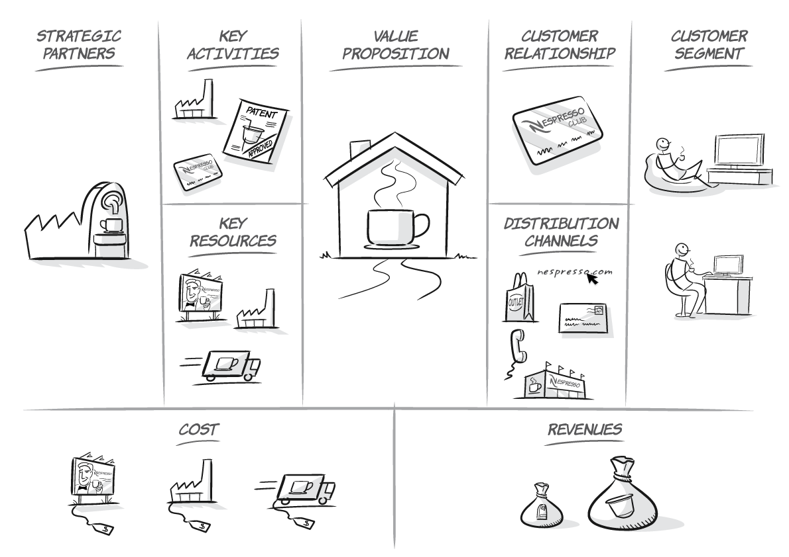

Slide 14


Slide 15
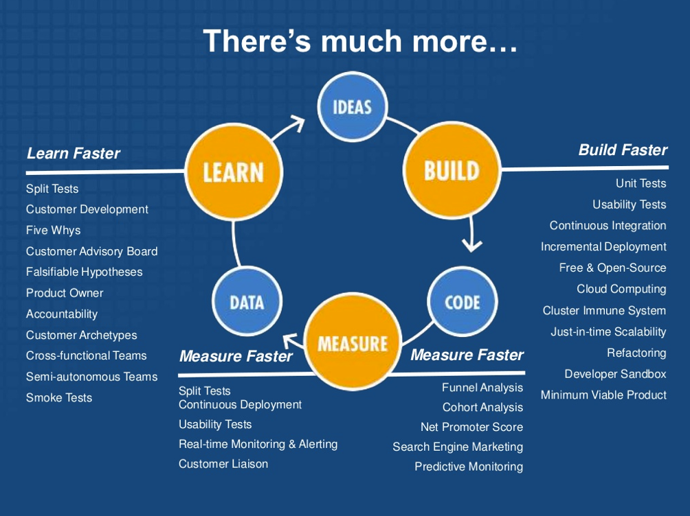

Slide 16


Minimum Viable Products (MVPs)
‘Minimum viable product is the most misused term in entrepreneurship. It does not mean Prototype!
https://www.youtube.com/watch?v=xPJoq_QVsY4

Slide 17
Useful Resources
Books
Running Lean by Ash Mauyra
Lean Analytics by Alistair Croll and Benjamin Yoskovitz
Lean Customer Development by Cindy Alvarez
The Lean Startup by Eric Ries
Lean UX by Jeff Gothelf
Online
www.talkingtohumans.com
www.udacity.com/course/how-to-build-a-startup--ep245
hbr.org/2013/05/why-the-lean-start-up-changes-everything
www.steveblank.com
playbook.samaltman.com
startupclass.samaltman.com
www.startuplessonslearned.com

Slide 18


